Slide 1

Image Credit: Ayn Rand Institute/ Seita via Shutterstock.com
How does America feel about immigration?
A DATA ANALYSIS ABOUT THE IMPACT OF IMMIGRATION IN THE AMERICAN SENTIMENTS.
BY M. HASHER, J. MENDIOLA & R. ORR

Slide 2


Contents
Overview
Questions to be asked
Data Sources
APIs
CSV files
Strategy
Analysis
Conclusions
Q1
Q2
Q3
Q4
DATA ANALYTICS BOOTCAMP
How America feels about immigration?

Slide 3
Questions
Is there a correlation between Twitter sentiment and immigration stock and/or flows?
How other indicators are correlated with immigration?

Slide 4
Approach
-Matching the Twitter accounts of local NPR news stations along with Twitter accounts of local television stations with counties.
-Use the data obtained along with US Census data to evaluate the relationship between the sentiment of these news Tweets and their replies with foreign-born share of the population.
DATA ANALYTICS BOOTCAMP
How America feels about immigration?

Slide 5

Data Sources
Census Data- CSV files: United States counties, population estimates, sanctuary cities, immigration rates, crime rates
Media Data- CSV files: NPR Twitter handles and local television Twitter handles
API’s- Twitter API was used to search local NPR affiliates and television station tweets by the following filters-
“Immigration , immigrant , immigrants , foreigner , non-citizen , undocumented , non-citizen ,
’permanent resident”. The API also allowed us to geo-locate the tweet.
DATA ANALYTICS BOOTCAMP
How America feels about immigration?

Slide 6
Data Exploration / Cleanup
In this section we have to use Jupyter notebook to explain. My suggestion is to use a link to the actual notebooks instead of using images.
EXAMPLE:
Hate Crime Dataframe
NPR Stations Dataframe
Census Dataframe
DATA ANALYTICS BOOTCAMP
How America feels about immigration?

Slide 7
Analysis Process
We have to use again our Jupyter Notebooks in this section (not sure what exactly we have to explain here)
These are the last 3 points mentioned in the instructions provided by the TA’s:
The analysis process (accompanied by your Jupyter Notebook)
Your conclusions. This should include a numerical summary as well as visualizations of that summary
Discuss the implications of your findings. This is where you get to have an open-ended discussion about what your findings "mean".
I guess in this section we can just explain what strategy we followed for our analysis, and in Conclusions/Findings section we can answer the Questions to be asked and include our graphs in those answers.
DATA ANALYTICS BOOTCAMP
How America feels about immigration?

Slide 8
Conclusions
EXAMPLE
Is there a correlation between hate crime rate and the negativity of sentiment analysis?
Based in our scatter plot we can conclude that in those counties where the sentiment analysis is negative, the hate crime rate is higher than average and….
DATA ANALYTICS BOOTCAMP
How America feels about immigration?

Slide 9
Conclusions
HATE CRIME RATE DISTRIBUTION OVER TIME (2012-2016)
(This is a GIF going from 2012 to 2016 Hate Crime rates)
DATA ANALYTICS BOOTCAMP
How America feels about immigration?

Slide 10
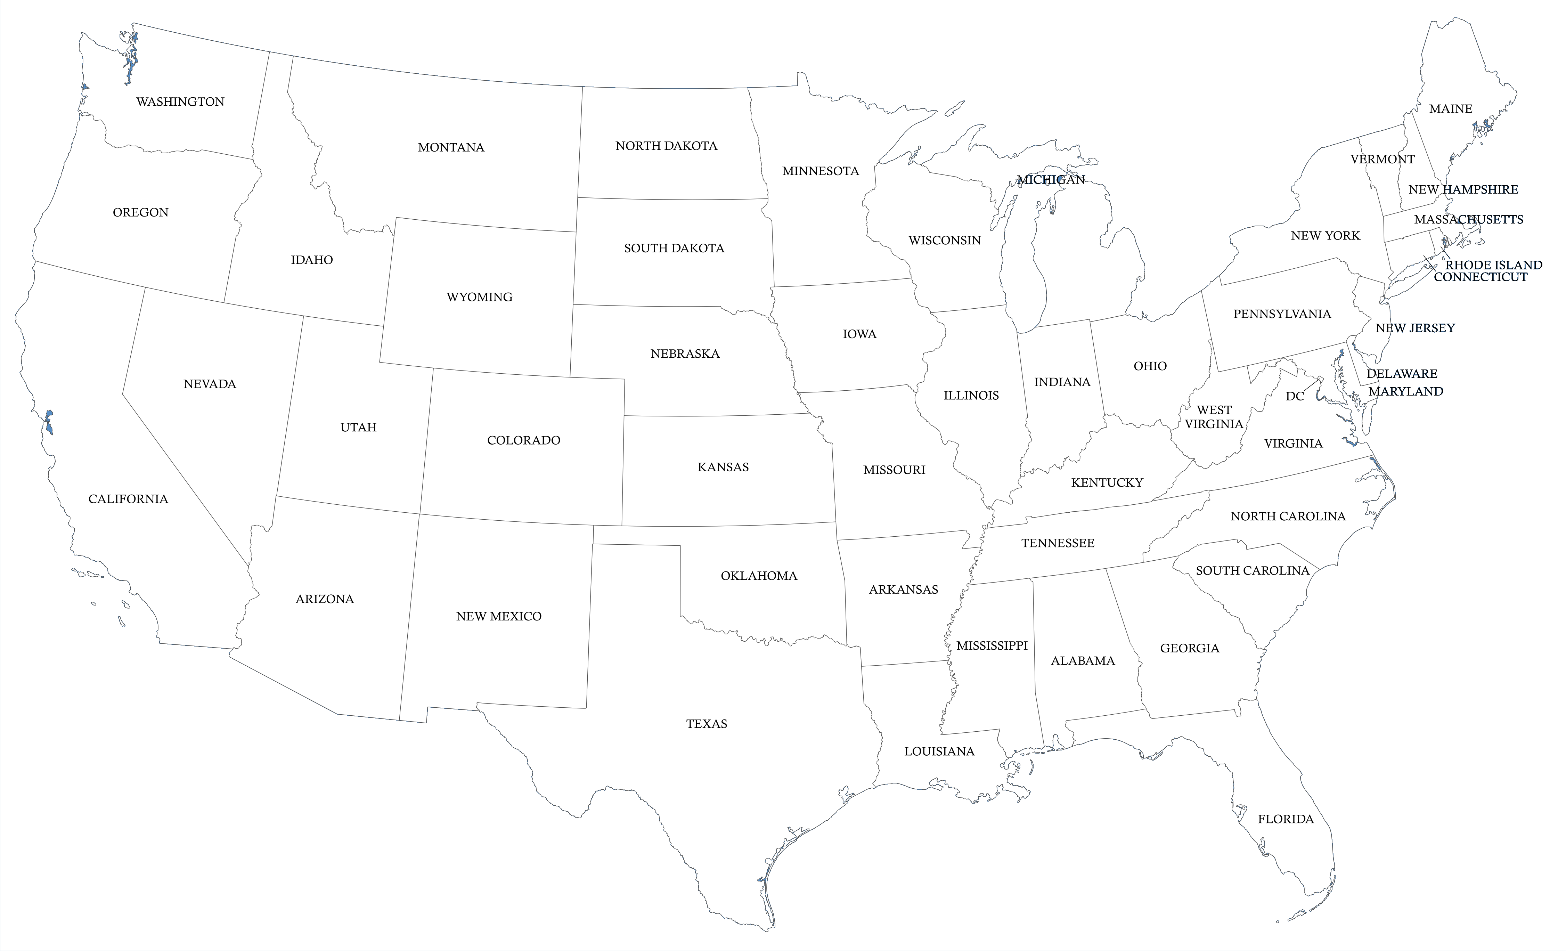
Thank you

